Slide 1


Slide 2


Slide 3

Task 2: - Finding Vulnerabilities and loophole using Automatic Vulnerability Scanner on website
http://zero.webappsecurity.com/

Slide 4
Above website is an online bank portal name as Zero Online Banking. Zero Banking provide a greener and more convenient way to manage a money. It enables to check your account balance, transfer money and keep a record of your transactions. Zero Online Banking is a vulnerable website. A vulnerable website allows an attacker to gain some level of control of the site, and possibly the hosting server. Here I have use NESSUS an Automatic Vulnerability Scanner to find automatic vulnerability on Zero Bank Portal. Using Nessus, I have found almost 145 vulnerabilities on the website. Here I have found almost 18 critical vulnerabilities on website. Some of the Critical Vulnerabilities found are: - 1) Unsupported Web Server Detection 2) Apache Tomcat Multiple Vulnerability 3) Open SSL Unsupported 4) Apache HTTP Server (Multiple Server) 5) Apache Httpd (Multiple Server)

Slide 5
Vulnerabilities Statistic
Risk | Number of Vulnerability
Critical | 18
High | 32
Medium | 49
Low and Info | 46

Slide 6
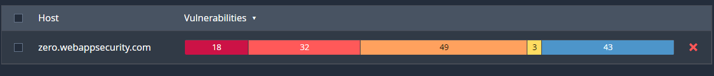
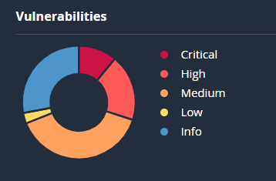
Vulnerabilities Status

Slide 7
As Open SSL Unsupported is one of the critical VPR Top Threats vulnerability. Zero Online banking website http://zero.webappsecurity.com/ has an endpoint that is vulnerable to a vulnerability- namely as Open SSL Unsupported. As Open SSL is high severe vulnerability that allow that an attacker to change an application behaviour or cause the app to crash. This vulnerability arises due to the remote web server is running a version of Open SSL that is no longer supported to this server. Lack of support implies that no security patches for the product will be released by the vendor. As the result, it is likely to contain some of Security Vulnerabilities.
Vulnerability Report on Open SSL Unsupported

Slide 8
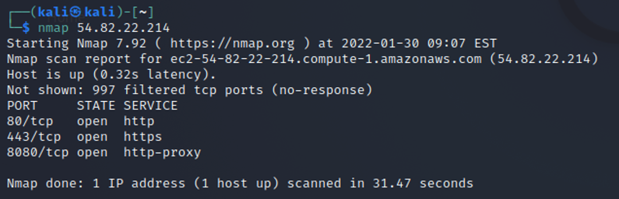
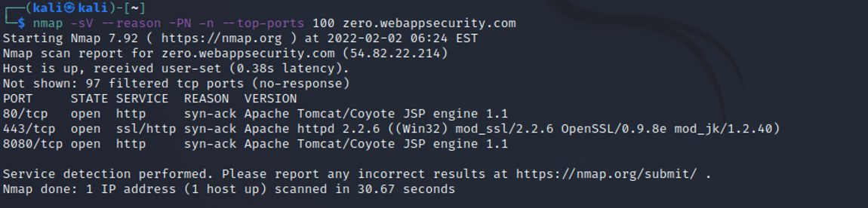

Step to reproduce: -
Using Nmap, I have scanned the website to know which Port are open. As Open SSL is open on 443/tcp port.

Slide 9
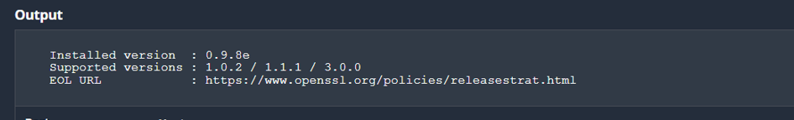
Observation: -
I have observed that remote web server is running on old version of Open SSL that is no longer supported. As long as the vulnerable version of OpenSSL is in use it can be abused. If we keep continue to use it, as a result it can be likely to contain the security vulnerabilities too.
Risk: -
Open SSL patches high-severity vulnerability. It causes a severe impact on server. It allow the attacker to change an application behaviour or cause the app to crash.
Recommendation: -
Upgrade to the latest and supported version of OpenSSL.

Slide 10
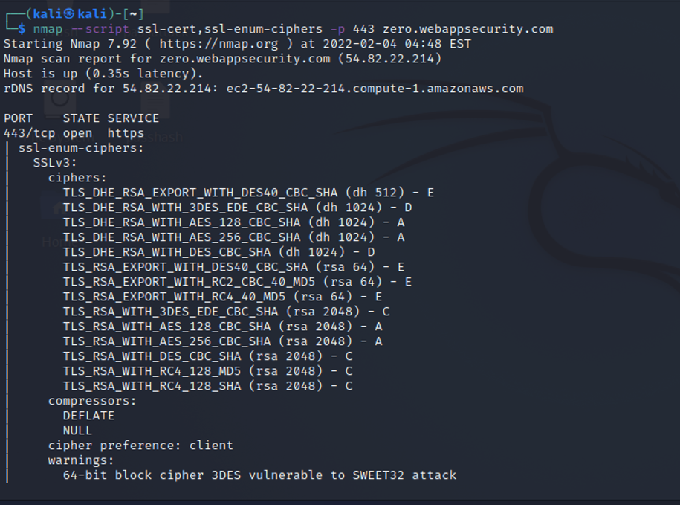
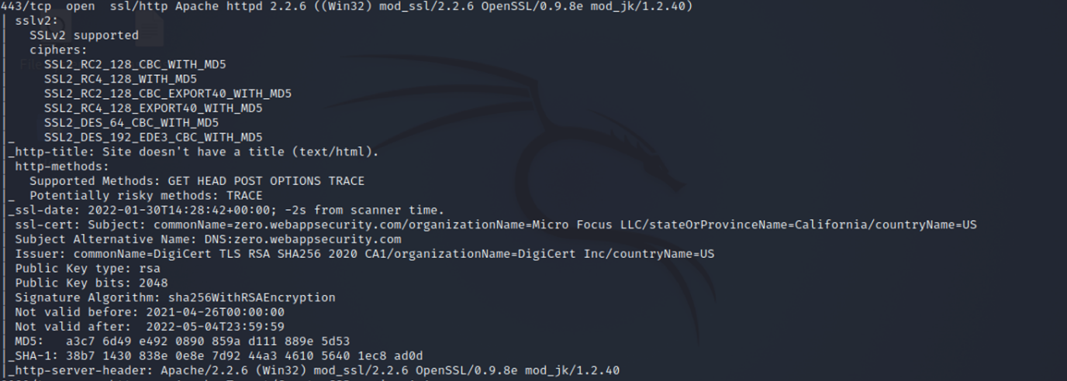
Checking the Vulnerable Area in OpenSSL: -
1) Website is vulnerable to SSLv2 and SSLv3:-
As SSLv2 is older implementation of Secure Socket Layer Protocol. It suffers from a number of Security flaws allowing attackers to capture and alter information passes between a client and server. No protection against man-in-the-middle attacks during handshake.
SSLV3 has several flaws, so it too is not secure. An attacker can cause connection failure and they can trigger use of SSL to exploit other vulnerabilities like POODLE. Attacker can also perform main-in-the-middle attack and observe the encryption traffic between your website and visitor.

Slide 11
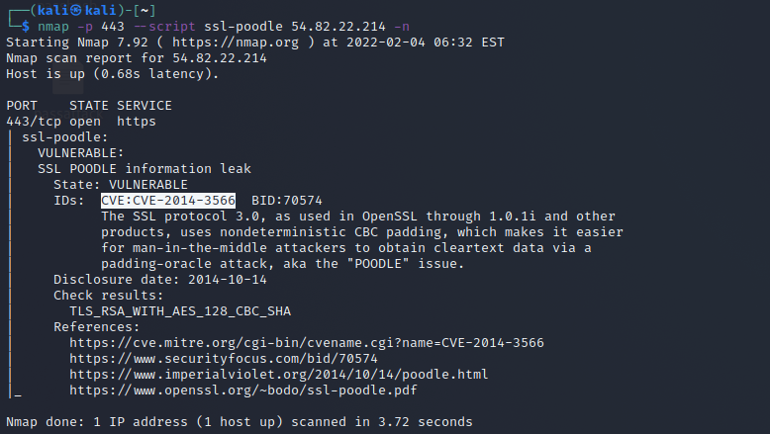
2) Website is vulnerable to SSL-POODLE: -
POODLE stands for Padding Oracle On Downgraded Legacy Encryption. This vulnerability allow an man-in-middle attacker to decrypt ciphertext using a padding oracle side-channel attack. POODLE affects older standards of encryption, specifically Secure Socket Layer (SSL) version 3. This vulnerability affects all products that include product compliant with SSL version 3.0.

Slide 12
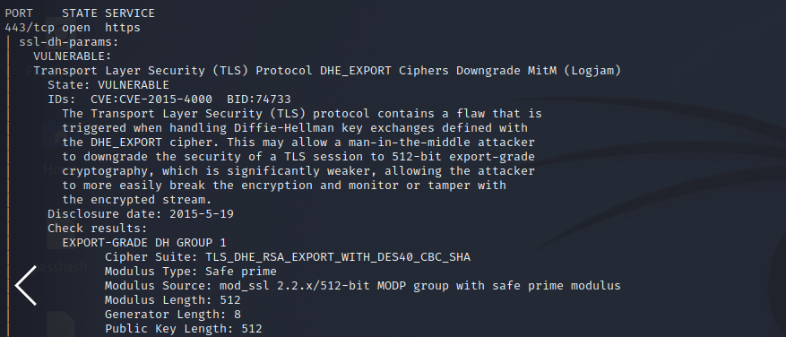
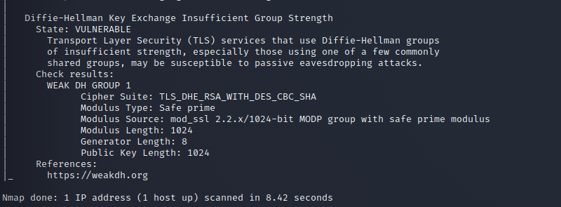
3) Website is Vulnerable to SSL-dh-Params: - Weak ephemeral Diffie-Hellman parameter detection for SSL/TLS services. Sender and Receiver make a common secret key in Diffie-Hellman algorithm and then they start communicating with each other over the public channel which is known to everyone. In this attack, the attacker tries to stop the communication happening between sender and receiver and attacker can do this by deleting messages or by confusing the parties with miscommunication. Some more attacks like Insider attack, Outsider attack, etc are possible on Diffie-Hellman. To reduce the possibility of attacks on Diffie-Hellman algorithm, we have enhanced the Diffie-Hellman algorithm to a next level.

Slide 13
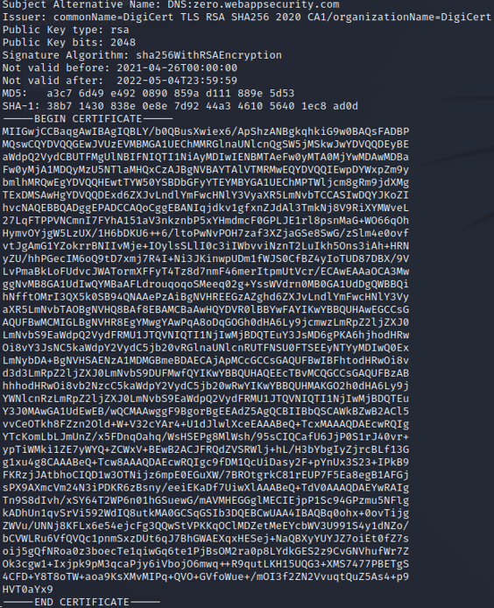
4) Website is Vulnerable for SSL Certificate: - SSL establishes an encrypted link between the browser and server. Whatever data is passed between these two, SSL ensures that it is private and secure. When using an expired certificate, you risk your encryption and mutual authentication. As a result, both your website and users are susceptible to attacks and viruses. For example, a hacker can take advantage of a website with an expired SSL certificate and create a fake website identical to it. Fixing expired certificates is a vital process that protects your site from theft and damage.

Slide 14
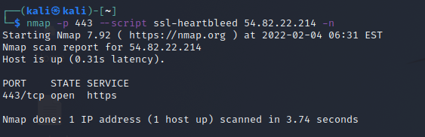
5) Website is Vulnerable to SSL-Heartbleed: - The Heartbleed Bug is a serious vulnerability in the popular OpenSSL cryptographic software library. This weakness allows stealing the information protected, under normal conditions, by the SSL/TLS encryption used to secure the Internet. SSL/TLS provides communication security and privacy over the Internet for applications such as web, email, instant messaging (IM) and some virtual private networks (VPNs). The Heartbleed bug allows anyone on the Internet to read the memory of the systems protected by the vulnerable versions of the OpenSSL software. This compromises the secret keys used to identify the service providers and to encrypt the traffic, the names and passwords of the users and the actual content. This allows attackers to eavesdrop on communications, steal data directly from the services and users and to impersonate services and users.

Slide 15
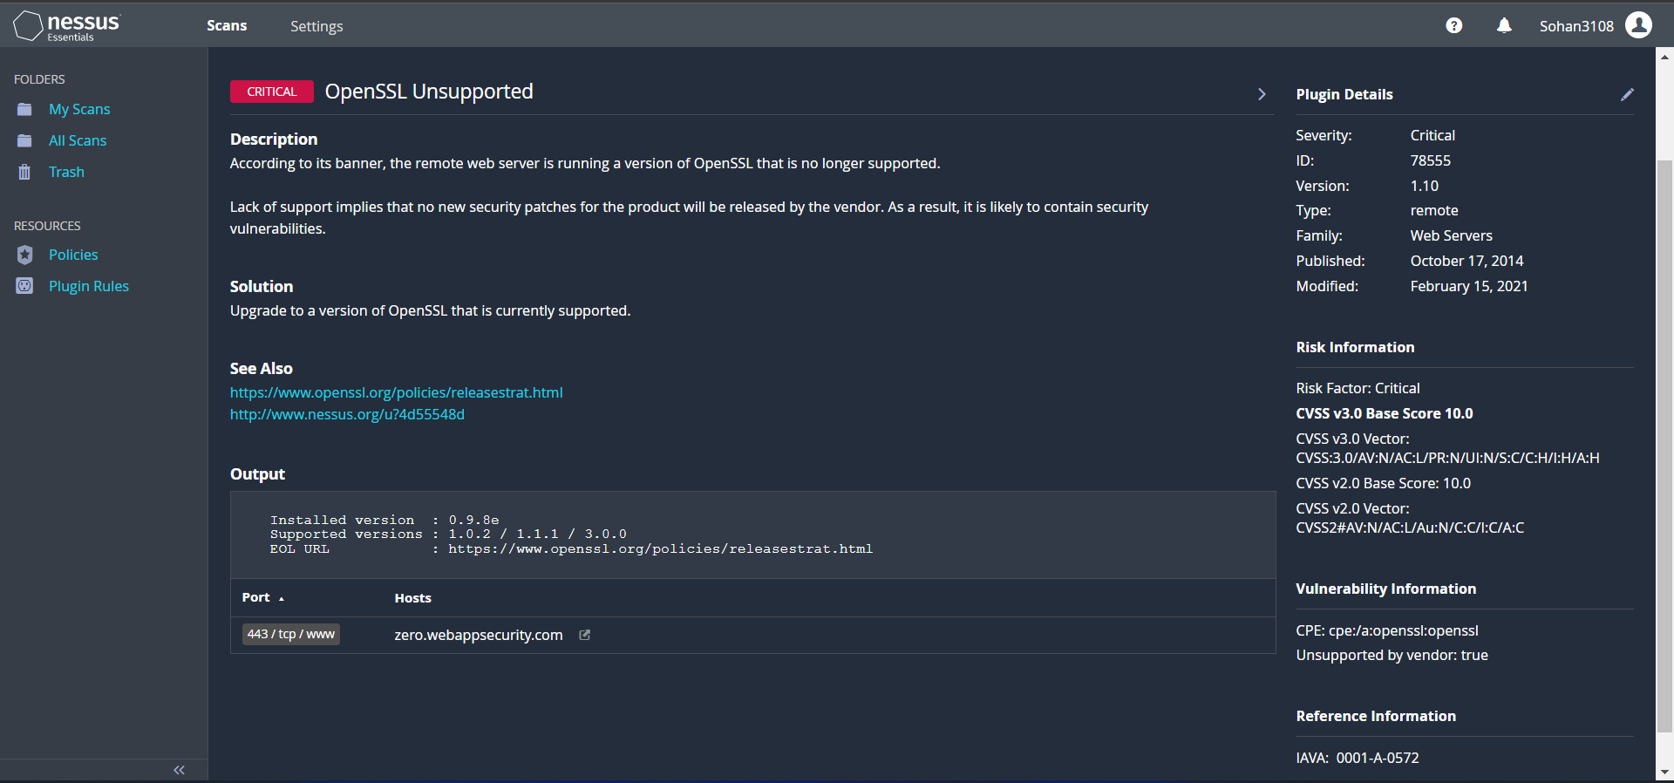
Vulnerability Report by NESSUS

